Slide 1


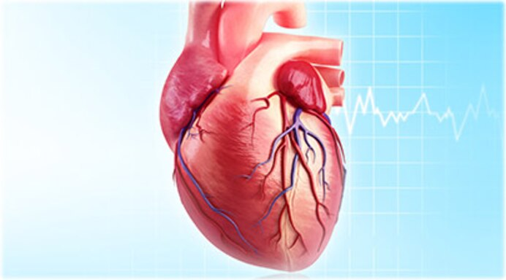
Congestive Heart Failure
Mrs. Jagtap P.N
Assistant Professor & HOD of Pharmacology.
PDEA’S SGRS College of Pharmacy.

Slide 2
CONGESTIVE HEART FAILURE
Heart (or cardiac) failure:
It is defined as the inefficiency of the heart to pump sufficient amount of oxygenated blood to the organs to meet the metabolic demands and to collect the blood from the organs.
Congestive heart failure (CHF):
It is complex clinical syndrome characterized by abnormalities of left ventricular function and neurohormonal regulation, which are accompanied by effort intolerance, fluid retention, and reduced longevity
2

Slide 3
What Is Heart Failure?
Heart failure does not mean the heart has stopped working.
Heart works less efficiently than normal.
Due to various possible causes, blood moves through the heart and body at a slower rate, and pressure in the heart increases. As a result, the heart cannot pump enough oxygen and nutrients to meet the body's needs. The chambers of the heart may respond by stretching to hold more blood to pump through the body or by becoming stiff and thickened. This helps to keep the blood moving, but the heart muscle walls may eventually weaken and become unable to pump as efficiently. As a result, the kidneys may respond by causing the body to retain fluid (water) and salt.

Slide 4
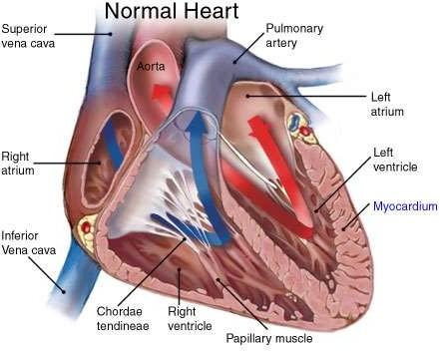
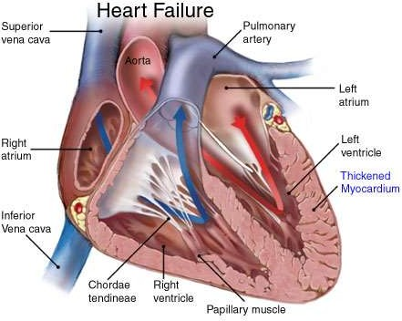
3

Slide 5
Pathophysiology
Normal filling capacity of left ventricle is about 130 ml, out of which about 70ml undergoes ejection, while the remaining volume persist in the ventricles.
The volume of blood ejected from the left ventricle reduces to about 55ml
In condition of left ventricular systolic dysfunctioning.
Any factor that tends to increase the stress on the heart or lead to myocardial infraction results in left ventricular systolic dysfunction.
(LVSD).
The eventual consequences is an impairment in the systolic contraction or diastolic relaxation or both.
Imapariment in the contracting ability of the heart results in systolic dysfunction ,due to this ejection faction tends to get lowered.
The diastolic function is concerned with the filling of the ventricles, such filling is governed by the venous return and adequate dilation of the ventricles.
9

Slide 6
Clinical condition that results in systolic and systolic dysfunctioning include:
Hypertension
Aortic stenosis
Valvular defects
Acute myocardial infraction
Cardiomyopathies
Thus the ventricles fails to fill in the required volume of blood and also fails in its subsequent ejection.
This results in the drastic reduction in the stroke volume and cardiac output.
A decrease in cardiac ouput leads to reduced perfusion of essential organs.
The body tries to compensate for the reduced cardiac output by stimulating the functioning of various compensatory mechanisims

Slide 7
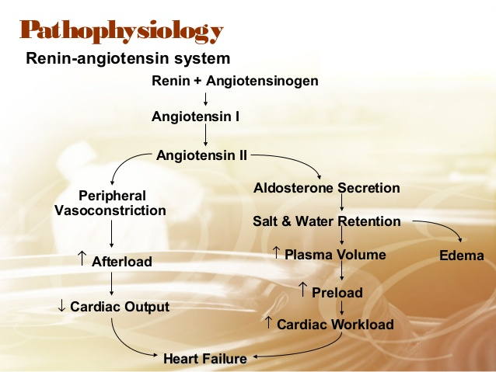

Slide 8
What Causes Heart Failure?
Heart failure is caused by many conditions that damage the heart muscle, including:
Coronary artery disease.
Coronary artery disease (CAD), a disease of the arteries that supply blood and oxygen to the heart, causes decreased blood flow to the heart muscle. If the arteries become blocked or severely narrowed, the heart becomes starved for oxygen and nutrients.
Heart attack.
A heart attack occurs when a coronary artery becomes suddenly blocked, stopping the flow of blood to the heart muscle. It will damages the heart muscle, resulting in a scarred area that does not function properly.
Cardiomyopathy.
Damage to the heart muscle because of infections or alcohol or drug abuse.
Conditions that overwork the heart.
Conditions including high blood pressure, valve disease, thyroid disease, kidney disease, diabetes, or heart defects present at birth can all cause heart failure. In addition, heart failure can occur when several diseases or conditions are present at once.

Slide 9
What Are the Symptoms of Heart Failure?
Congested lungs. Fluid backup in the lungs can cause shortness of breath with exercise or difficulty breathing at rest or when lying flat in bed. Lung congestion can also cause a dry, hacking cough or wheezing.
Fluid and water retention. Less blood to kidneys causes fluid and water retention, resulting in swollen ankles, legs, abdomen (called edema), and weight gain. Symptoms may cause an increased need to urinate during the night. Bloating in your stomach may cause a loss of appetite or nausea.
Dizziness, fatigue, and weakness. Less blood to your major organs and muscles makes feel tired and weak. Less blood to the brain can cause dizziness or confusion.
Rapid or irregular heartbeats. The heart beats faster to pump enough blood to the body. This can cause a rapid or irregular heartbeat.

Slide 10
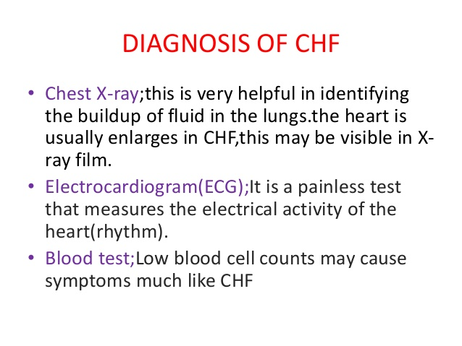
How Is Heart Failure Diagnosed?
medical history (coronary artery disease, angina, diabetes, heart valve disease, and high blood pressure).
Life style (smoke, drugs, drink alcohol) Etc

Slide 11
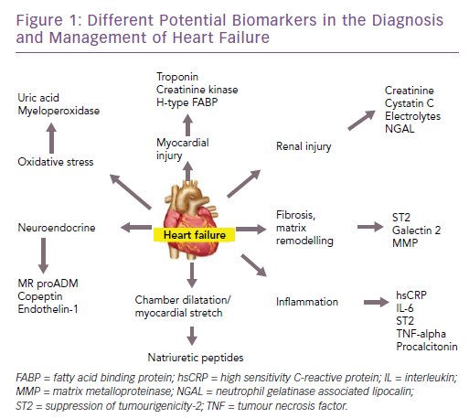

Slide 12
Types of CHF
Congestive heart failure
BASED ON
Amount of cardiac output
Position of heart failure
Low cardiac output failure
Left side cardiac failure
Right side Cardiac failure
High cardiac output failure
12

Slide 13
Based on amount of cardiac output
Low-cardiac output failure
It is most common congestive heart failure.
The metabolic demands of the body organs are normal with in limits but the heart fails to pump sufficient amount of oxygenated blood to the organs of the body.
The primary cause of LCOF is the ventricular systolic dysfunction and ventricular diastolic dysfunction.
Ventricular systolic dysfunction
Myocardial infarction weakens the muscles of ventricles and make them inefficient to pump the required volume of blood.
Thus results in low cardiac output and low ejection fraction.
Ventricular diastolic dysfunction
Hypertrophy is responsible for the stiffening of heart muscle
The stiffened muscle of the ventricles fails to relax during diastolic and thus cannot collect sufficent amount of blood.
This ultimately results in low cardiac output.
13

Slide 14
High cardiac output failure
It occurs very rarely.
Hyperthyroidism , anaemia enhances the metabolic demands of the body for myocardial oxygen ,which cannot be met even by the increased pumping action of the heart.
Low cardiac output failure | High cardiac output failure
Most frequent | Very rarely
Metabolic demands of the body organs for oxygen are normal and within limits | Metabolic demands of the body for oxygen is very high
Myocardial fraction is prominent factor leading to the failure of systolic & diastolic function of the ventricles, ultimetly results in low cardiac output failure | Hyperthyroidism, anaemia, causes high cardiac output failure.
14

Slide 15
Based on the position of heart failure
The failure of either right side or left side of the heart to pump the blood leads to the failure of the other side and ultimately results in the failure of the both sides of the heart.
Left side cardiac failure
The failure of the left ventricle to pump the entire blood present in it during systole results in retention of some amount of blood after every systole.
Thus blood is accumulated in the left ventricle after few systole of the heart.
The left ventricle fails to accept the blood from auricles and lungs thus the uncollected blood due to back-up pressure remains in the lungs resulting in pulmonary oedema.
15

Slide 16
Right side cardiac failure
The failure of right ventricle to pump the entire blood present in it during systole results in retention of some amount of blood after every systole.
Thus blood is accumulated in right ventricle after few systoles.
The Right ventricle fails to accept the blood from peripheral organs and ultimately results in generalized systemic oedema or peripheral oedema.
Left side cardiac failure | Right side cardiac failure
Is the result of right side cardiac failure. | Is the result of left side cardiac failure.
Inefficent pumping action of left ventricle is responsible for the accumulation of blood in the ventricles. | Inefficient pumping action of right ventricle is responsible for the accumulation of blood in right ventricle.
Left ventricle fails to accept/collect the blood from lungs due to back pressure | Right ventricle fails to accept/collect the blood from peripheral organs.
Pulmonary congestion/oedema is the final result | Peripheral generalized oedema is the final result
16

Slide 17
TREATMENT
It has two parts:
1.Non pharmacological Treatment
2. Pharmacological Treatment
Non pharmacological Treatment
Physical Exercise
Salt Intake
Fluid Intake
Alcohol Consumption

Slide 18
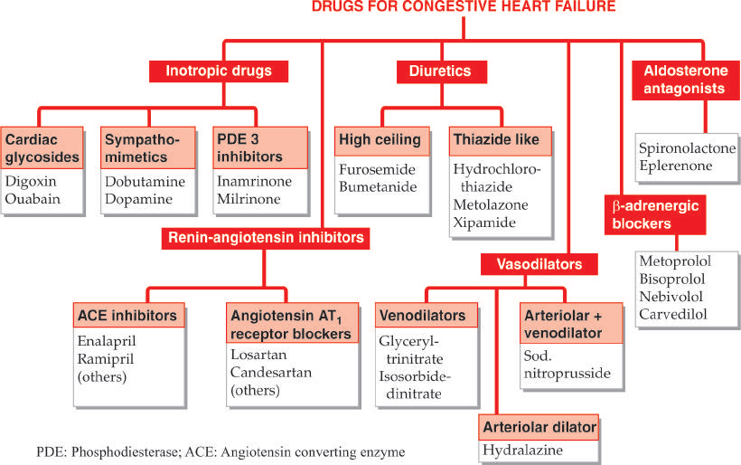

Slide 19
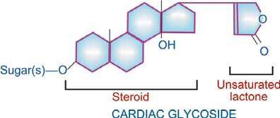
CHEMISTRY
All are glycosides; consist of an aglycone (genin) to which are attached one or more sugar (glucose or digitoxose) moieties. The pharmacological activity resides in the aglycone, but attached sugars modify solubility and cell permeability. In general, aglycones have short lived and less potent action.
The aglycone consists of a cyclopentanoperhydrophenanthrene (steroid) ring to which is attached a 5 or 6 membered unsaturated lactone ring. One or more hydroxyl and other substitutions are present on the aglycone and determine its polarity,

Slide 20
Digoxin's primary mechanism of action involves inhibition of the sodium potassium adenosine triphosphatase (Na+/K+ ATPase), mainly in the myocardium. This inhibition causes an increase in intracellular sodium levels, resulting in decreased activity of the sodium-calcium exchanger, which normally imports three extracellular sodium ions into the cell and transports one intracellular calcium ion out of the cell. The reversal of this exchanger causes an increase in the intracellular calcium concentration that is available to the contractile proteins. Increased intracellular calcium lengthens phase 4 and phase 0 of the cardiac action potential, which leads to a decrease in heart rate. Increased amounts of Ca²⁺ also leads to increased storage of calcium in the sarcoplasmic reticulum, causing a corresponding increase in the release of calcium during each action potential. This leads to increased contractility (the force of contraction) of the heart without increasing heart energy expenditure.
Digoxin also has important parasympathetic effects, particularly on the atrioventricular node. While it does increase the magnitude of myocardial contractility, the duration of the contraction is only slightly increased. Its use as an antiarrhythmic drug, then, comes from its direct and indirect parasympathetic stimulating properties.

Slide 21
Vagus nerve stimulation slows down conduction at the AV node by increasing the refractory period of cardiac myocytes. The slowed AV node gives the ventricles more time to fill before contracting. This negative chronotropic effect is synergistic with the direct effect on cardiac pacemaker cells. The pumping function of the heart improves, owing to improved filling.
Overall, the heart rate is decreased while stroke volume is increased, resulting in a net increase in blood pressure, leading to increased tissue perfusion. This causes the myocardium to work more efficiently, with optimized hemodynamics and an improved ventricular function curve.
Other electrical effects include a brief initial increase in action potential, followed by a decrease as the K⁺ conductance increases due to increased intracellular amounts of Ca²⁺ ions. The refractory period of the atria and ventricles is decreased, while it increases in the sinoatrial and AV nodes. A less negative resting membrane potential is made, leading to increased irritability. The conduction velocity increases in the atria, but decreases in the AV node. The effect upon Purkinje fibers and ventricles is negligible. Automaticity is also increased in the atria, AV node, Purkinje fibers, and ventricles.
ECG changes seen in people taking digoxin include increased PR interval and a shortened QT interval. Also, the T wave may be inverted and accompanied by ST depression. It may cause AV junctional rhythm and ectopic beats resulting in ventricular tachycardia and fibrillation.

Slide 22
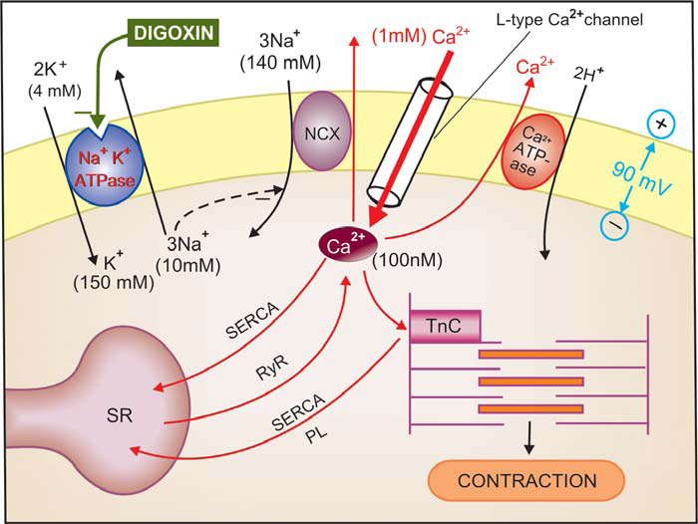

Slide 23
PHARMACOLOGICAL ACTIONS
Rate :
Heart rate is decreased by digitalis. Bradycardia is more marked in CHF patients: improved circulation (due to positive inotropic action) restores the diminished vagal tone and abolishes sympathetic overactivity. In addition, digitalis slows the heart by vagal and extravagal actions.
2. Tone:
It is defined by the maximum length of the fibre at a given filling pressure, or the resting tension in the muscle fibre. This is not affected by therapeutic doses of digitalis. However, digitalis does decrease end diastolic size of a failing ventricle, but this is a consequence of better ventricular emptying and a reduction in filling pressure.

Slide 24
3. Heart Digitalis has direct effects on myocardial contractility and electrophysiological properties. In addition, it has vagomimetic action, reflex effects due to alteration in haemodynamics and direct CNS effects altering sympathetic
activity.
Force of contraction Digitalis causes a dose dependent increase in force of contraction of
heart—a positive inotropic action. This is especially seen in the failing heart which is exquisitely sensitive. There is increased velocity of tension development and higher peak tension can be generated. Systole is shortened, diastole is prolonged. When a normal heart is subjected to increased impedance to outflow, it generates increased tension so that stroke volume is maintained upto considerably higher values of
Impedance, while the failing heart is not able to do so and the stroke volume progressively
decreases. The digitalized failing heart regains some of its capacity to contract more Digitalis increases force of contraction in normal heart as well, but this is not translated into increased output, because the normal heart empties nearly completely even otherwise and reduction of end diastolic volume is counterproductive.
4. Action Potential

Slide 25
2. Blood vessels
Digitalis has mild direct vasoconstrictor action—peripheral resistance is increased in normal individuals. However, in CHF patients this is more than compensated by the indirect effect of improvement in circulation, i.e. reflex sympathetic over activity is withdrawn and a net decrease in peripheral resistance occurs. Venous tone is improved in normal individuals as well as in CHF patients. Digitalis has no prominent effect on BP: systolic BP may increase and diastolic may fall in CHF patients—pulse pressure increases. Hypertension is no contraindication to the use of digitalis. Despite a weak direct coronary constrictor action, therapeutic doses of digitalis have no significant effect on coronary circulation— coronary insufficiency is no contraindication to its use. Coronary debt may even decrease if ventricles were in a dilated state.

Slide 26
3. Kidney
Diuresis is seen promptly in CHF patients, secondary to improvement in circulation and renal perfusion. The retained salt and water is gradually excreted. No diuresis occurs in normal individuals or in patients with edema due to other causes.
4. CNS
Digitalis has little apparent CNS effect in therapeutic dose. Higher doses cause CTZ
activation → nausea and vomiting. Still higher doses produce hyperapnoea, central sympathetic stimulation, mental confusion, disorientation and visual disturbances.

Slide 27
PRECAUTIONS AND CONTRAINDICATIONS
(a) Hypokalemia: enhances digitalis toxicity by increasing its binding to Na+K+ ATPase.
(b) Elderly, renal or severe hepatic disease: patients are more sensitive.
(c) Myocardial infarction: severe arrhythmias are more likely. Digitalis should be used after MI only when heart failure is accompanied with AF and rapid ventricular rate.
(d) Thyrotoxicosis: reduces responsiveness to digitalis, but these patients are more prone to develop digitalis arrhythmias.
(e) Myxoedema: these patients eliminate digoxin more slowly; cumulative toxicity can occur.
(f) Ventricular tachycardia: digitalis is contraindicated— may precipitate ventricular fibrillation.
(g) Partial A-V block: may be converted to complete A-V block.
(h) Acute myocarditis: Diphtheria, acute rheumatic carditis, toxic carditis—inotropic response is poor, more prone to arrhythmias.

Slide 28
Cardiac glycosides - Digoxin • Pharmacokinetics: – Absorbed orally. Absorption varies from zero to nearly 100%.
Distributed widely to tissues, including the central nervous system.
Digoxin is not extensively metabolized in humans. Almost two thirds is excreted unchanged by the kidneys.
Its renal clearance is proportional to creatinine clearance, and the half-life is 36–40 hours in patients with normal renal function.

Slide 29
Adverse effects – Cardiac glycosides • Toxicity of digitalis is high, margin of safety is low (therapeutic index 1.5–3). Antidote for overdose of digoxin is Digoxin immune tab or Digoxin-specific antibody.
Adverse effects – Cardiac glycosides • Extracardiac: • Anorexia, nausea, vomiting, abdominal pain are due to gastric irritation, mesenteric vasoconstriction and CTZ stimulation.
•Fatigue, malaise, headache, mental confusion, restlessness, hyperapnoea, disorientation, psychosis and visual disturbances are the other complaints. • Skin rashes and gynaecomastia are rare.
Adverse effects – Cardiac glycosides • Cardiac: • Almost every type of arrhythmia can be produced by digitalis. Type of arrhythmia caused by cardiac glycoside is Tachyarrhythmias (caused by chronic use of digitalis and diuretics) Infuse KCl 20 m.mol/hour i.v. or give orally in milder cases Ventricular arrhythmias. Lidocaine Supraventricular arrhythmias Propranolol may be given i.v. or orally depending on the urgency A-V block and bradycardia Atropine 0.6–1.2 mg i.m.

Slide 30
Uses • Used in the treatment of congestive heart failure (systolic and diastolic dysfunctions) and cardiac arrhythmias (atrial fibrillation, atrial flutter and paroxysmal supraventricular tachycardia).

Slide 31
Sympathomimetics:
Dobutamine is a direct-acting agent whose primary activity results from stimulation of the β₁-adrenoceptors of the heart, increasing contractility and cardiac output. Since it does not act on dopamine receptors to inhibit the release of norepinephrine (another α₁ agonist), dobutamine is less prone to induce hypertension than is dopamine.
Dobutamine is predominantly a β₁-adrenergic agonist, with weak β₂ activity, and α₁ selective activity, although it is used clinically in cases of cardiogenic shock for its β₁ inotropic effect in increasing heart contractility and cardiac output. Dobutamine is administered as a racemic mixture consisting of both (+) and (−) isomers; the (+) isomer is a potent β₁ agonist and α₁ antagonist, while the (−) isomer is an α₁ agonist. The administration of the racemate results in the overall β₁ agonism responsible for its activity. (+)-Dobutamine also has mild β₂ agonist activity, which makes it useful as a vasodilator.

Slide 32
Dopamine shows its effects depending on dosage, include an increase in sodium excretion by the kidneys, an increase in urine output, an increase in heart rate, and an increase in blood pressure. At low doses it acts through the sympathetic nervous system to increase heart muscle contraction force and heart rate, thereby increasing cardiac output and blood pressure. Higher doses also cause vasoconstriction that further increases blood pressure.
While some effects result from stimulation of dopamine receptors, the prominent cardiovascular effects result from dopamine acting at α₁, β₁, and β₂ adrenergic receptors.

Slide 33
WHAT IS DOBUTAMINE?
Dobutamine Injection is a catecholamine indicated when parenteral therapy is necessary for inotropic support in the short-term treatment of adults with cardiac decompensation due to depressed contractility resulting either from organic heart disease or from cardiac surgical procedures.
WHAT IS DOPAMINE?
Dopamine (dopamine hydrochloride) is a catecholamine drug that acts by inotropic effect on the heart muscle (causes more intense contractions) that, in turn, can raise blood pressure. At high doses, Dopamine may help correct low blood pressure due to low systemic vascular resistance. Dopamine is used to treat hypotension (low blood pressure), low cardiac output, and reduced perfusion of body organs due to shock, trauma, and sepsis.

Slide 34
Common side effects of Dobutamine include:
increased heart rate and increased blood pressure,
ventricular ectopic activity,
nervousness,
headache,
nausea,
vomiting,
palpitations,
low platelet counts (thrombocytopenia), or
swelling at the injection site.
serious side effects of dobutamine
low blood pressure,
chest pain (angina),
fast or slow heartbeat,
shortness of breath, or
trouble breathing.
Common side effects of Dopamine include:
Irregular heartbeats
Nausea
Vomiting
Anxiety
Headache
Chills
Goosebumps
Shortness of breath
Serious side effects of Dopamine include:
Heart arrhythmias that can be life-threatening
Kidney damage
Gangrene of digits at the higher doses.

Slide 35
phosphodiesterase-3 inhibitor : Inamrinone, Milrinone
Mechanism of action:
cAMP causes increased activation of protein kinase A (PKA). PKA is an enzyme that phosphorylates many elements of the contractile cells within the heart cell. In the short term this leads to an increased force of contraction. Phosphodiesterases are enzymes responsible for the breakdown of cAMP. Therefore, when phosphodiesterases lower the level of cAMP in the cell they also lower the active fraction of PKA within the cell and reduce the force of contraction.
Milrinone is a phosphodiesterase-3 inhibitor. This drug inhibits the action of phosphodiesterase-3 and thus prevents degradation of cAMP. With increased cAMP levels there is an increase in the activation of PKA. This PKA will phosphorylate many components of the cardiomyocyte such as calcium channels and components of the myofilaments. Phosphorylation of calcium channels permits an increase in calcium influx into the cell. This increase in calcium influx results in increased contractility. PKA also phosphorylates potassium channels promoting their action. Potassium channels are responsible for repolarization of the cardiomyocytes therefore increasing the rate at which cells can depolarize and generate contraction. PKA also phosphorylates components on myofilaments allowing actin and myosin to interact more easily and thus increasing contractility and the inotropic state of the heart. Milrinone allows stimulation of cardiac function independently of β-adrenergic receptors which appear to be down-regulated in those with heart failure.

Slide 36
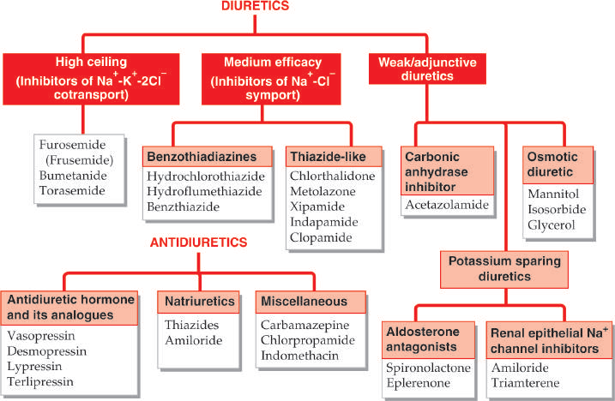

Slide 37
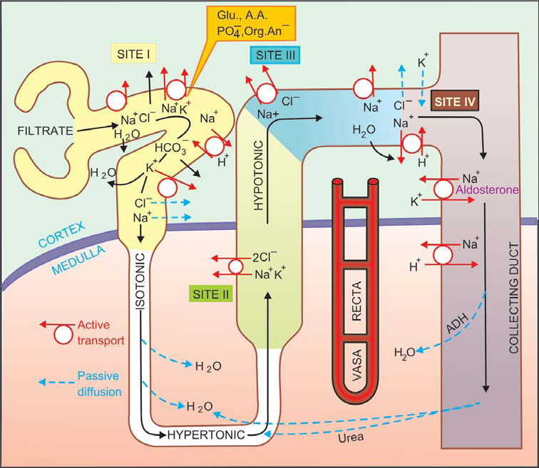

Slide 38
High Ceiling Diuretics / High efficacy diuretics/ Loop Diuretics (Sulphamoyl derivatives) (Inhibitors of Na+-K+- 2Cl¯ cotransport)
e.g: Furosemide, Bumetanide, Torasemide
Furosemide (Frusemide)
Prototype drug. Its maximal natriuretic effect is much greater than that of other classes. The diuretic response goes on increasing with increasing dose: upto 10 L of urine may be produced in a day. It is active even in patients with relatively severe renal failure. The onset of action is prompt (i.v. 2–5 min., i.m. 10–20 min., oral 20–40 min.)

Slide 39
The major site of action is the thick AscLH (site II) where furosemide inhibits Na+- K+-2Cl¯ cotransport . It is secreted in PT by organic anion transport and reaches AscLH where it acts from luminal side of the membrane. It abolishes the cortico medullary osmotic gradient and blocks positive as well as negative free water clearance.
K+ excretion is increased mainly due to high Na+ load reaching DT. However, at equinatriuretic doses, K+ loss is less than that with thiazides.
Furosemide has weak CAse inhibitory action and increase HCO3¯ excretion. Its action is independent of acid-base balance of the body.

Slide 40
Furosemide increases Ca2+ excretion (contrast thiazides which reduce it) as well as Mg2+ excretion. It tends to raise blood uric acid level by competing with its proximal tubular secretion as well as by increasing reabsorption in PT which is a consequence of reduced e.c.f. volume.
Pharmacokinetics
Furosemide is rapidly absorbed orally but bioavailability is about 60%. Lipid-solubility is low, and it is highly bound to plasma proteins. It is partly conjugated with glucuronic acid and mainly excreted unchanged by glomerular filtration as well as tubular secretion. Some excretion in bile and directly in intestine also occurs. Plasma t½ averages 1–2 hour but is prolonged in patients with pulmonary edema, renal and hepatic insufficiency.

Slide 41
Molecular mechanism of action:
A glycoprotein with membrane spanning domains has been found to function as the Na+-K+-2Cl¯ cotransporter in many epithelia performing secretory/ absorbing function, including AscLH. Recently, distinct absorptive or secretory isoforms of Na+-K+- 2Cl¯ cotransporter have been isolated. The former is exclusively expressed at the luminal membrane of thick AscLH—furosemide attaches to the Cl¯ binding site of this protein to inhibit its transport function. The secretory form is expressed on the basolateral membrane of most glandular and epithelial cells.

Slide 42
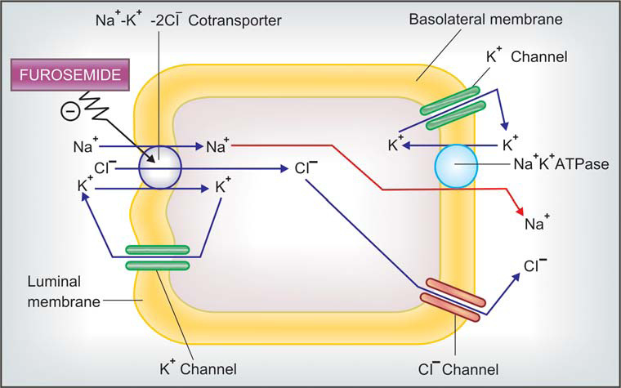
Bumetanide
It is similar to furosemide in all respects, but is 40 times more potent. It induces
very rapid diuresis and is highly effective in pulmonary edema.
Torasemide (Torsemide)
Another high ceiling diuretic with properties similar to furosemide, but
3 times more potent.

Slide 43
THIAZIDE AND RELATED DIURETICS (Inhibitors of Na+-Cl¯ symport)
Thiazide diuretics control hypertension in part by inhibiting reabsorption of sodium (Na⁺) and chloride (Cl⁻) ions from the distal convoluted tubules in the kidneys by blocking the thiazide-sensitive Na⁺-Cl⁻ symporter. The term "thiazide" is also often used for drugs with a similar action that do not have the thiazide chemical structure, such as chlorthalidone and metolazone. These agents are more properly termed thiazide-like diuretics.Thiazide diuretics also increase calcium reabsorption at the distal tubule

Slide 44
Pharmacokinetics :
All thiazides and related drugs are well absorbed orally; are administered only by this route. Their action starts within 1 hour, but the duration varies from 8–48 hours. The more lipid-soluble agents have larger volumes of distribution (some are also tissue bound), lower rates of renal clearance and are longer acting. The protein binding is also variable. Most of the agents undergo little hepatic metabolism and are excreted as such. They are filtered at the glomerulus as well as secreted in the PT by organic anion transport. Tubular reabsorption depends on lipid solubility: the more soluble ones are highly reabsorbed—prolonging duration of action.

Slide 45
Chlorthalidone:
It is a particularly long acting agent with a t½ 40–50 hours, used exclusively as antihypertensive.
Metolazone:
In common with loop diuretics, it is able to evoke a clinically useful response even in severe renal failure (g.f.r. ~15 ml/min), and has marked additive action when combined with furosemide. An additional proximal tubular action has been demonstrated; PO4 reabsorption that occurs in PT is inhibited. It is excreted unchanged in urine.
Xipamide:
It has a pronounced diuretic action similar to low doses of furosemide. Because of longer duration of action—hypokalemia is more prominent.
Indapamide :
It has little diuretic action in the usual doses, probably because it is highly lipid soluble, is extensively metabolized and only small quantity of unchanged drug is present in the tubular fluid. However, it retains antihypertensive action and is used for that purpose only.

Slide 46
Complications of high ceiling and thiazide type diuretic therapy
1. Hypokalaemia
2. Dilutional hyponatraemia
3. GIT and CNS disturbances
4. Hearing loss
5. Allergic manifestations
6. Hyperuricaemia
7. Hyperglycaemia and hyperlipidemia
8. Hypercalcaemia
9. Magnesium depletion

Slide 47
Interactions
1. Hypokalaemia induced by these diuretics:, Enhances digitalis toxicity.
2. High ceiling diuretics and aminoglycoside antibiotics are both ototoxic and nephrotoxic; produce additive toxicity; should be used together cautiously.
3. Cotrimoxazole given with diuretics has caused higher incidence of thrombocytopenia.
4. Indomethacin and other NSAIDs diminish the action of high ceiling diuretics. Inhibition of PG synthesis in the kidney, through which furosemide and related drugs induce intrarenal haemodynamic changes which secondarily affect salt output. Antihypertensive action of thiazides and furosemide is also diminished by NSAIDs.
5. Probenecid competitively inhibits tubular secretion of furosemide and thiazides: decreases their action by reducing the concentration in the tubular fluid, while diuretics diminish uricosuric action of probenecid.
6. Serum lithium level rises when diuretic therapy is instituted. This is due to enhanced reabsorption of Li+ (and Na+) in PT.

Slide 48
CARBONIC ANHYDRASE INHIBITORS
Carbonic anhydrase is an enzyme found in red blood cells and many other tissues that catalyses the following reaction:
H₂CO₃ ⇌ H₂O + CO₂hence lowering blood pH, by means of the following reaction that carbonic acid undergoes:
H₂CO₃ ⇌ HCO₃⁻ + H⁺
Acetazolamide is a carbonic anhydrase inhibitor, hence causing the accumulation of carbonic acid. The mechanism of diuresis involves the proximal tubule of the kidney. The enzyme carbonic anhydrase is found here, allowing the reabsorption of bicarbonate, sodium, and chloride. By inhibiting this enzyme, these ions are excreted, along with excess water, lowering blood pressure, intracranial pressure, and intraocular pressure. By excreting bicarbonate, the blood becomes acidic, causing compensatory hyperventilation with deep respiration, increasing levels of oxygen and decreasing levels of carbon dioxide in the blood.

Slide 49
Pharmacokinetics
Acetazolamide is well absorbed orally and excreted unchanged in urine. Action of a single dose lasts 8–12 hours.
Adverse effects are frequent.
Acidosis, hypokalaemia, drowsiness, fatigue, abdominal discomfort.
Hypersensitivity reactions—fever, rashes.
Bone marrow depression is rare but serious. It is contraindicated in liver disease: may precipitate hepatic coma by interfering with urinary elimination of NH3 (due to alkaline urine). Acidosis is more likely to occur in patients of COPD.

Slide 50
POTASSIUM SPARING DIURETICS
These are either aldosterone antagonist or directly inhibit Na+ channels in DT and CD cells to indirectly conserve K+.
Spironolactone (Aldosterone antagonist) It is a steroid, chemically related to the mineralocorticoid aldosterone. Aldosterone acts on the late DT and CD cells by combining with an intracellular mineralocorticoid receptor → induces the formation of ‘aldosterone-induced proteins’ (AIPs) which promote Na+ reabsorption by a number of mechanisms and K+ secretion. Spironolactone acts from the interstitial side of the tubular cell, combines with the mineralocorticoid receptor and inhibits the formation of AIPs in a competitive manner. It has no effect on Na+ and K+ transport in the absence of aldosterone, while under normal circumstances, it increases Na+ and decreases K+ excretion.

Slide 51
Pharmacokinetics:
The oral bioavailability of spironolactone from microfine powder tablet is 75%. It is highly bound to plasma proteins and completely metabolized in liver; converted to active metabolites, the most important of which is Canrenone that is responsible for 1/2–2/3 of its action in vivo. The t½ of spironolactone is 1–2 hours, while that canrenone is ~18 hours. It undergoes some enterohepatic circulation.

Slide 52
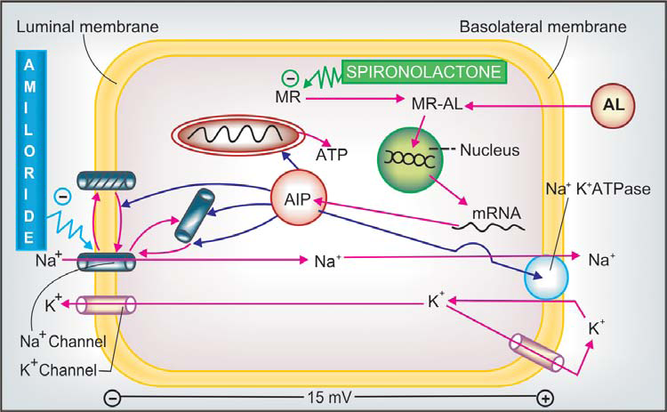

Slide 53
Inhibitors of renal epithelial Na+ channel
Triamterene and amiloride are two nonsteroidal organic bases with identical actions. Their most important effect is to decrease K+ excretion, particularly when it is high due to large K+ intake or use of a diuretic that enhances K+ loss. This is accompanied by a small increase in Na+ excretion.
Mechanism of action
https://www.youtube.com/watch?v=WxpPJOgn9BE

Slide 54
Triamterene
It is incompletely absorbed orally, partly bound to plasma proteins, largely metabolized in liver to an active metabolite and excreted in urine. Plasma t½ is 4 hours, effect of a single dose lasts 6–8 hours.
Side effects are infrequent:
consist of nausea, dizziness, muscle cramps and rise in blood urea. Impaired glucose tolerance and photosensitivity.
Amiloride
It is 10 times more potent than triamterene (dose 5–10 mg OD–BD). At higher doses it also inhibits Na+ reabsorption in PT. It decreases Ca2+ excretion. It is not bound to plasma proteins. The t½ (10–20 hours) and duration of action are longer than triamterene.

Slide 55
OSMOTIC DIURETICS
Mannitol
Osmotic diuretics have their major effect in the proximal convoluted tubule and the descending limb of the Loop of Henle. These sites are freely permeable to water. Through osmotic effects, they also oppose the action of ADH in the collecting tubule. The presence of a non reabsorbable solute such as mannitol prevents the normal absorption of water by interposing a countervailing osmotic force. As a result, urine volume increases.
The increase in urine flow rate decreases the contact time between fluid and the tubular epithelium, thus reducing sodium as well as water reabsorption.

Slide 56
Any osmotically active agent that is filtered by the glomerulus but not reabsorbed causes water to be retained in these segments and promotes a water diuresis. Such agents can be used to reduce intracranial pressure and to promote prompt removal of renal toxins. The prototypical osmotic diuretic is mannitol. Mannitol lowers the intra cranial pressure through two effects in the brain. The first, rheological effect, reduces blood viscosity, and promotes plasma expansion and cerebral oxygen delivery. In response, cerebral vasoconstriction occurs due to autoregulation, and cerebral blood volume is decreased. The second effect occurs through creation of an osmotic gradient across the blood-brain barrier, leading to the movement of water from the parenchyma to the intravascular space. Brain tissue volume is decreased and, therefore, ICP is lowered.
Isosorbide and glycerol
These are orally active osmotic diuretics which may be used to reduce intraocular or intracranial tension. Intravenous glycerol can cause haemolysis.
https://www.youtube.com/watch?v=Ze3JnG4LDkE

Slide 57
Vasodilators:
Venodilators (primarily ↓ preload)
Glyceryl trinitrate
Isosorbide dinitrate
Arteriolar dilators (primarily ↓ after load)
Hydralazine
Minoxidil
Ca2+ channel blockers (Nifedipine)
Pot. channel openers (Nicorandil)
Mixed dilators (↓ pre- and after load)
ACE Inhibitors
AT1 antagonists (ARBs)
Prazosin (α1 blocker)
Amrinone, Milrinone
Nitroprusside

Slide 58
Vasodilators
Vasodilators are used i.v. to treat acute heart failure that occurs in advanced cases, as well as orally for long-term therapy of chronic CHF, and have become the mainstay of anti-CHF measures.
(i) Preload reduction:
Nitrates cause pooling of blood in systemic capacitance vessels and reduce ventricular end-diastolic pressure and volume. With reduction in size of ventricles, effectiveness of myocardial fibre shortening in causing ejection of blood during systole improves (Laplace relationship). Controlled i.v. infusion of glyceryl trinitrate affords rapid relief in acute left ventricular failure. However, a marked lowering of preload (by vasodilators + strong diuretics) may reduce output of a failing heart whose performance is dependent upon elevated filling
pressure. Occurrence of nitrate tolerance limits their utility in routine treatment of CHF.

Slide 59
(ii) Afterload reduction Hydralazine dilates resistance vessels and reduces aortic impedance so that even weaker ventricular contraction is able to pump more blood; systolic wall stress is reduced. It is effective in forward failure when cardiac index without a marked increase in central venous pressure. Marked tachycardia and fluid retention limit longterm use of hydralazine monotherapy.
(iii) Pre- and after load reduction ACE inhibitors/ ARBs are orally active medium efficacy nonselective arterio-venous dilators, while Sod. nitroprusside is high efficacy i.v. dilator with equal action on the two types of vessels. These drugs act by both the above mechanisms.

Slide 60
Beta blockers
https://www.youtube.com/watch?v=i_uM09BHwv0

Slide 61
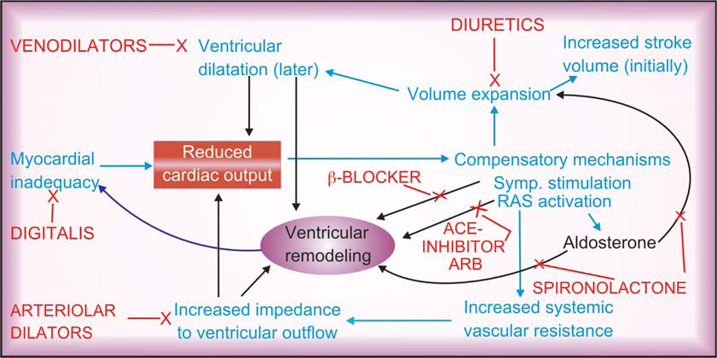

Slide 62
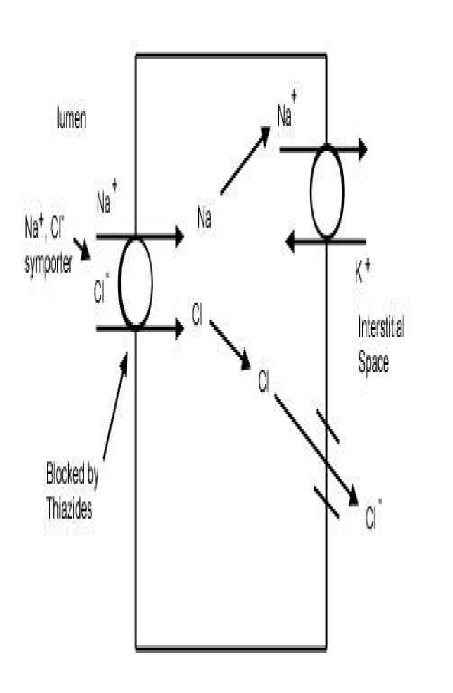
Thiazide Diuretics
Hydrochlorothiazide, metolazone, chlorthalidone
Thiazide diuretics inhibit the Na-Cl symporter.
This is a channel present on the luminal side of the distal convoluted tubule of the nephron and functions via secondary active transport.
Sodium enters the cell down it concentration gradient (“downhill”), while chlorine goes up its electrical gradient (inside of the cell is negative).
Chlorine is able to travel “uphill” without direct usage of energy because it uses the energy that sodium dissipates when it goes down its concentration gradient.
Once these two ions enter the cell, the sodium is shuttled across the basolateral side of the cell via Na/K ATPase (primary active transport) and chlorine travels across a chlorine channel (facilitated diffusion). (RFUMS, 2006)
Mechanism of Action of Thiazide Diuretics:
Individuals that suffer from high blood pressure are typically given thiazide diuretics. It is believed that thiazide inhibits the Na-Cl symporter by binding to the Cl- site of the transporter. This shuts down the pump and leads to excretion of sodium and chloride. By inhibiting these solutes to be reabsorbed into the plasma, they will cause the urine to have a greater concentration (increased amount of osmotically active solutes) and this will give water the gradient to remain in the filtrate. Also water will not be reabsorbed in the collecting tubule because the plasma osmolality will be reduced, so it will need to leave the plasma because the extracellular fluid osmolality will be low.
thiazide diuretics are successful at reducing blood pressure because they reduce the plasma volume. It is possible that thiazide diuretics also act to relax the smooth muscle of blood vessels to reduce the resistance to blood flow. Patients that take these medications will tend to have a greater frequency of urination accompanied by increased solute and water loss.
19

Slide 63
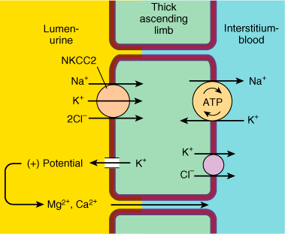
Loop Diuretics
Furosemide, Bumetanide , Torsemid
The Na+, K+, 2Cl- symporter, a carrier-mediated process,.
It is the major reabsorptive mechanism in the thick ascending limb (TAL).
All four ions are transported by secondary active transport into the TAL epithelial cells, at their apical surface, using the energy derived from the Na+/K+-ATPase co-transporter, also a carrier mediated mechanism.
Mechanism of Action of Loop Diuretics:
Loop diuretics act on the Na-K-2Cl symporter in the thick ascending limb of the loop of Henle to inhibit sodium and chloride reabsorption. Because magnesium and calcium reabsorption in the thick ascending limb is dependent on sodium and chloride concentrations.
loop diuretics also inhibit their reabsorption. By disrupting the reabsorption of these ions, loop diuretics prevent the urine from becoming dilute and disrupt the generation of a hypertonic renal medulla. Without such a concentrated medulla, water has less of an osmotic driving force to leave the collecting duct system, ultimately resulting in increased urine production. This diuresis leaves less water to be reabsorbed into the blood, resulting in a decrease in blood volume.
Loop diuretics cause vasodilation of the veins and of the kidney's blood vessels, mechanically causing a decrease in blood pressure. The collective effects of decreased blood volume and vasodilation decrease blood pressure.
Adverse reaction:
  pre-renal azotemia
  Hypokalemia
  Skin rash
  ototoxicity

Slide 64
Potassium-Sparing Diuretics
The K-sparing diuretics are weak diuretics alone.
They are primarily used as adjuncts to thiazides and loop diuretics or for potassium and magnesium spacing. Instead of using thiazides alone for hypertension ,triamterene is also used by combination.
Amiloride can be used for magnesium deficiency because it increases renal reabsorption.
If a patient who has hypomagnesemia, and you can't give them enough magnesium orally, because of laxative action, give amiloride.
Also, amiloride is useful for patients taking lithium who have polyuria and complain of having to get up three or four times at night. At a dose of 5 mg bid, amiloride reduces urine volume by 30%.
"Don't use any K-sparing diuretics with angiotensin-converting enzyme
inhibitors, angiotensin II receptor blockers [or] nonsteroidals.
Be cautioned against using them when serum creatinine levels are above 2 mg/dL.
Specific side effects seen with K-sparing diuretics include
Hyperchloremic acidosis;
Hyperkalemia, especially if administered with an ACE inhibitor, angiotensin II receptor
blocker or in patients with diabetes;
Gynecomastia, impotence in men or irregular menstrual cycles in women (only with use of spironolactone);
Folic acid deficiency (with chronic use of triamterene); or acute renal failure (with triamterene when used with indomethacin [Indocin]).

Slide 65
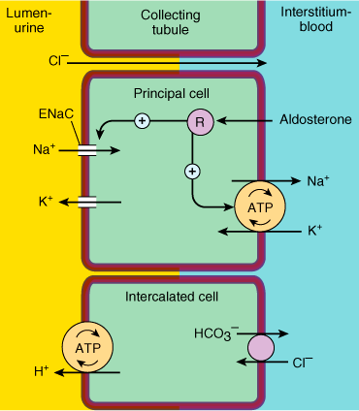
K⁺ Sparing Agents
Triamterene & amiloride – acts on distal tubules to ↓ K secretion
Spironolactone (Aldosterone
antagonist)
it improve survival in CHF patients due to the effect on renin-angiotensin- aldosterone system with subsequent effect on myocardial remodeling and fibrosis
Aldosterone inhibition minimize potassium loss, prevent sodium and water retention, endothelial dysfunction and myocardial fibrosis.

Slide 66
Renin–Angiotensin- System
The renin-angiotensin system (RAS) or the renin-angiotensin-aldosterone
system (RAAS) is a hormone system that regulates blood pressure and water (fluid) balance.
When blood volume is low, juxtaglomerular cellsin the kidneys secrete renin directly
into circulation.
Plasma renin then carries out the conversion of angiotensinogen released by the liver to angiotensin I.
Angiotensin I is subsequently converted to angiotensin II by the enzyme angiotensin converting enzyme found in the lungs.
Angiotensin II is a potent vaso-active peptide that causes blood vessels to constrict,
resulting in increased blood pressure.
Angiotensin II also stimulates the secretion of the hormone aldosterone from the adrenal cortex
Aldosterone causes the tubules of the kidneys to increase the reabsorption of sodium and water into the blood. This increases the volume of fluid in the body, which also increases blood pressure.
If the renin-angiotensin-aldosterone system is too active, blood pressure will be too high.
There are many drugs that interrupt different steps in this system to lower blood
pressure. These drugs are one of the main ways to control high blood pressure
(hypertension),hear failure,kidney failure, and harmful effects of diabetes.
23

Slide 67
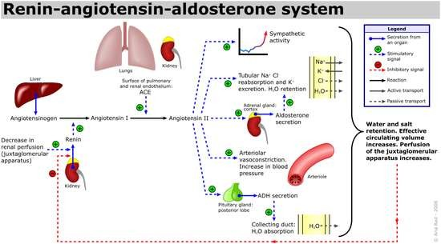

Slide 68
Inhibitors of Renin- Angiotensin- Aldosterone System
Angiotensin converting enzyme inhibitors
Angiotensin receptors blockers
Spironolactone (Aldosterone antagonist)

Slide 69
Angiotensin Converting Enzyme (ACE) Inhibitors
Captopril, Lisinopril, Enalapril, Ramipril, Quinapril.
Mode of action:
Angiotensin 1 Angiotensin 2
ACE Inhibitors
Hences, they inhibit the generation of angiotensin 2,a potent vasoconstrictor.
They also inhibit the release of aldosterone & vasopressin, thereby inhibiting fluid and slat retention thus decreasing the preload.
Elevate the levels of bradykinin, vasodilator thus enhancing renal & cardiac perfusion.

Slide 70
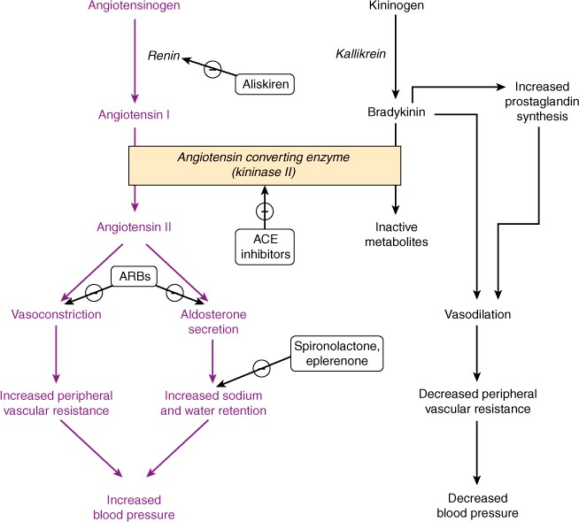
Scope for ACE Inhibitors…..
Drug reactions
Hypotension
Dry cough
Renal dysfunction
Proteinuria
Dizziness
Joint pain

Slide 71
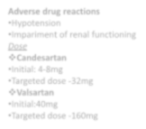
Angiotensin Receptor AT-1 blockers (ARB)
Losartan ,candesartan,valsartan
Angiotensin 2 ,a vasocontrictor is concerned with ventricular remodelling and fluid
retention.
These drugs inhibit the binding of angiotensin 2 to its AT₁ receptor.
Thus they preclude the a bove mentioned effects of angiotensin 2.
These agents do not exert any action on bradykinin and thus do not produce
cough.
Has comparable effect to ACE I
Can be used in certain conditions when ACE I are contraindicated
Adverse drug reactions
Hypotension
Impariment of renal functioning
Dose
Candesartan
Initial: 4-8mg
Targeted dose -32mg
Valsartan
Initial:40mg
Targeted dose -160mg

Slide 72
ACE-Inhibitors and ARB effects
Vasodilation
Decreased fluid retention (afterload & preload)
Reduction in aldosterone secretion
Inhibition of cardiac and vascular remodeling

Slide 73
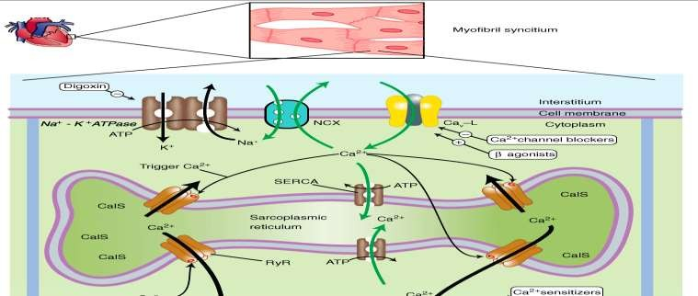
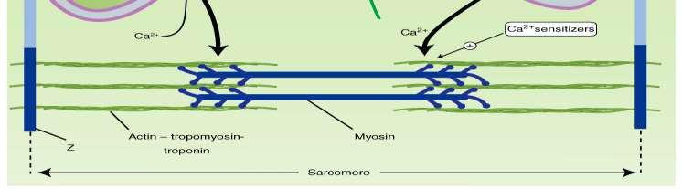
Inotropes
Increase force of contraction
All increase intracellular cardiac Ca⁺⁺ concentration
Eg:
  Digitalis (cardiac glycoside)
  Dobutamine (β-adrenergic recepter agonist)
– Amrinone (PDE inhibitor)

Slide 74
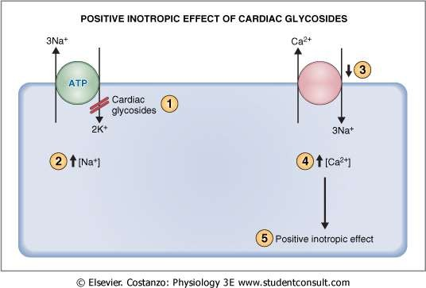
Cardiac glycosides : Digoxin (DIGITALIS)
It inhibits the inhibit Na ⁺,K ⁺ ATPase , pump which
Functions in the exchange of Na⁺ for k⁺ ions.
Such blockage results in intracellular
accumulation of Na⁺ ions .
These ions are then exchanged with Ca₂⁺ ions through Na⁺ - Ca₂⁺ exchange carries.
These ca₂⁺ ions increase the contractility of the myocardium which is beneficial to the failing heart.
Digoxin enhances the cholinergic activity which reduces the HR and AV conduction .
Due to this the time required for diastolic filling gets enhanced while the myocardial o2 consumption is retarted.
The sympathetic outflow comprising renin, aldosterone is also decreased by dioxin

Slide 75
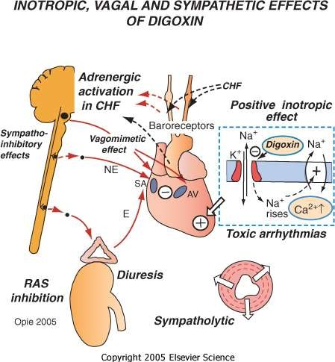
Drug reaction
Bradycardia
Nausea
Vomiting
Visual disturbances
Non paroxysomal junctional tachycardia
Supraventricular
tachycardia
Sexual dysfunction
Neuralgic pain
USES:
For tachyarrhythmias
For ventricular arrhythmias

Slide 76
β -Adrenergic Agonists
Dopamine
Dopamine acts at a variety of receptors (dose dependant)
Rapid elimination- can only be administered as a continuous infusion
Dobutamine
Stimulates beta-adrenergic receptors and produces a positive inotropic response.
Unlike the vasoconstriction seen with high doses of dopamine, dobutamine produces a mild vasodilatation

Slide 77
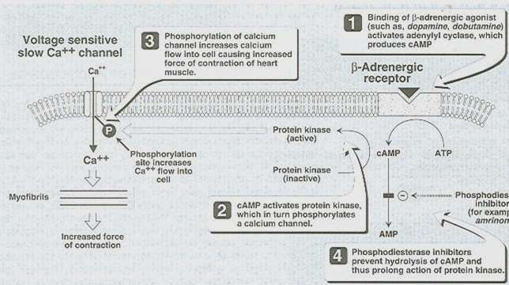
β Adrenergic Agonist

Slide 78
BIPYRIDINES
phosphodiesterase inhibitors
Targets PDE -3 (found in cardiac and smooth muscle)
Ex. Inamrinone , milrinone
alter the intracellular movements of calcium by influencing the sarcoplasmic reticulum
increasing inward calcium flux
in the heart during
the
action potential
increase myocardial contractility
Inhibition of PDE3
Increase in cAMP
the conversion of inactive protein
kinase to active form
Protein kinases are responsible for
phosphorylation of Ca channels
increased Ca entry into the cell
vasodilation
increase in
contractility
↑ Vascular Permeability leads to
↓ in intravascular fluid Volume
35

Slide 79
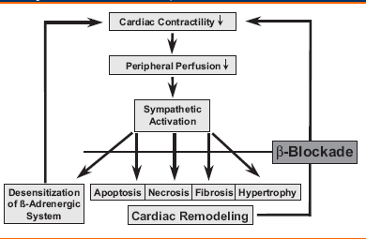
β1 Blockers
bisoprolol, carvedilol , metoprolol
MOA
Heart failure is accompanied by an increase activation of sympathetic nervous system.
This brings about structural & functional modification in the myocardium.
β Blockers inhibit the sympathetic outflow of norepinephrine and counteract the changes produced.
The ventricular remodelling in heart failure is also reversed by
β Blockers
Increases beta receptor sensitivity.
Adverse drug reaction
Hypotension
Bradycardia
Worsening of CHFsymptoms.

Slide 80
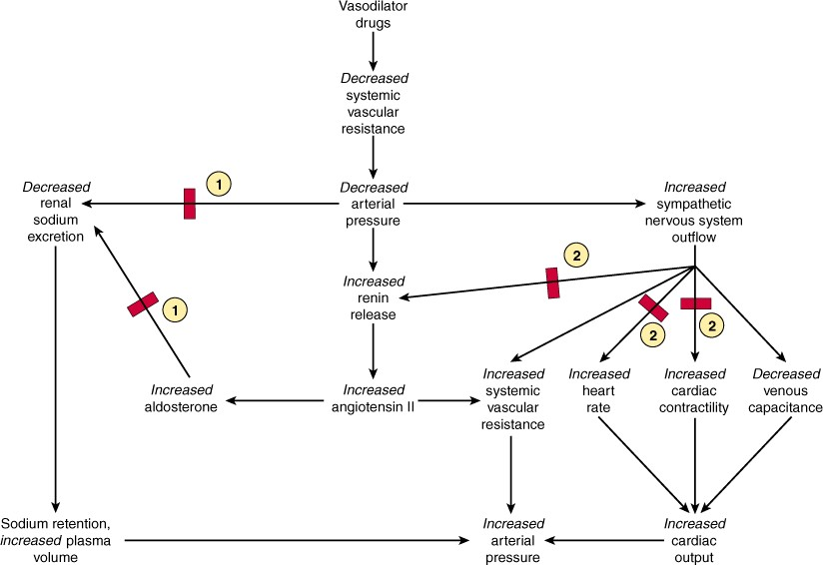
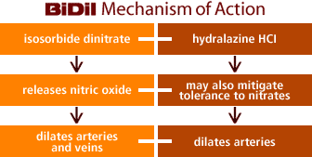
Vasodilators
Isosorbide dinitrate, isosorbide mononitrate, and hydralazine also used specially in patients who cannot tolerate ACE inhibitors.

Slide 81
Vasodilator(Hydralazine)
It directly relaxes the arterioles & arteries reducing the peripheral vascular reesistances & preload.
It also help to reduce after load.
Adverse drug reaction:
Nausea
Palpitation
Tachycardia
Salt & water retention on prolong therapy.

Slide 82
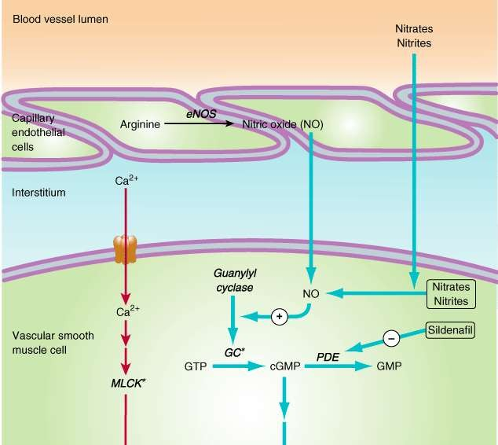
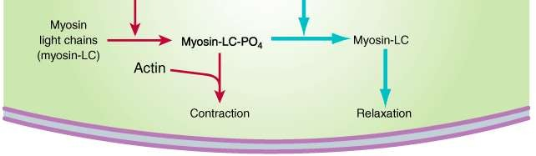
NITRATES & NITRITES
Nitroglycerin is denitrated by glutathione S -transferase in smooth muscle
Free nitrite ion is released, which is then converted to Nitric
Oxide
activation of guanylyl cyclase enzyme
increase in cGMP
dephosphorylation of myosin light chain , preventing the interaction of myosin with actin(Myosin light chain kinase essential for smooth muscle contraction).
Results in vasodilation

Slide 83
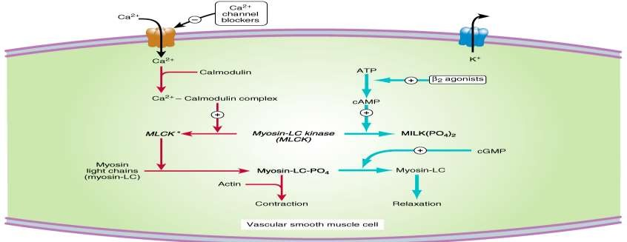
Calcium Channel Blockers for Vasodialation
Nisoldipine , Isradipine
bind more effectively to open channels and inactivated channels (inner side of the membrane)
reduces the frequency of opening in response to depolarization
marked decrease in transmembrane calcium current
activation of myosin light chain kinase
Vascular smooth muscle (the most sensitive
long-lasting relaxation

Slide 84
NISIRITIDE(BNP)
Brain (B-type) natriuretic peptide (BNP) is secreted constitutively by ventricular myocytes in response to stretch
Niseritide = recombinant human BNP
Naturally occurring atrial natriuretic peptide may vascular
permeability may reduce intravascular volume)
Main Side Effect:
hypotension

Slide 85
Human BNP binds to the particulate guanylate cyclase receptor of vascular smooth muscle and endothelial
intracellular concentrations (cGMP) ↑ smooth muscle cell relaxation
dilate veins and arteries
systemic and pulmonary vascular resistances ↑
Indirect ↑ in cardiac output and diuresis.
Effective in HF because preload and afterload↓

Slide 86
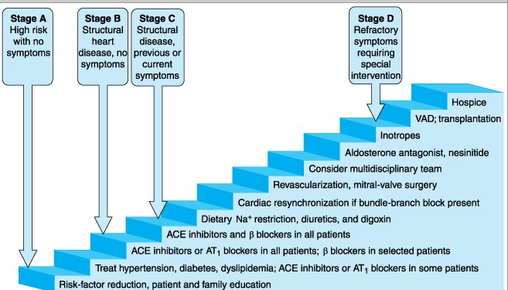
Heart Failure Treatment Algorithm

